Slide 1
Hiding Stars with Fireworks: Location Privacy through Camouflage Joseph Meyerowitz, RomitRoy Choudhury MobiCom 09’
-Sowhat 09.11.18

Slide 2
Outlines
Motivation
Basic Concepts of LBS(Location-Based Service)
Limitations of Existing Works
CacheCloak – how does it work?
Results & Analysis
Conclusion

Slide 3
Motivation
Location Based Services(LBS)
ex. Display shopping list while passing by supermarket
Risk from LBSs
Existing work – Tradeoff between privacy/functionality
CacheCloak – realtime anonymization of location data

Slide 4
Basic Concepts of LBS
LBS which requiring ID, called trusted LBSs, cannot be used in anonymous way.
Untrusted LBSs
Attacker could be hostile untrusted LBS or
anyone with access to an untrusted LBS’s data
Location-only structure
Querying Frequency affects privacy

Slide 5
Limitations of Existing Works
K-Anonymity
K-anonymous region in space ➔ spatial accuracy ↓
K-anonymous region in time, CliqueCloak ➔ not realtime
Pseudonyms
Each new location is sent to the LBS with a new pseudonym
Frequent updating and distinguishable queries still may causes the trail revealed

Slide 6
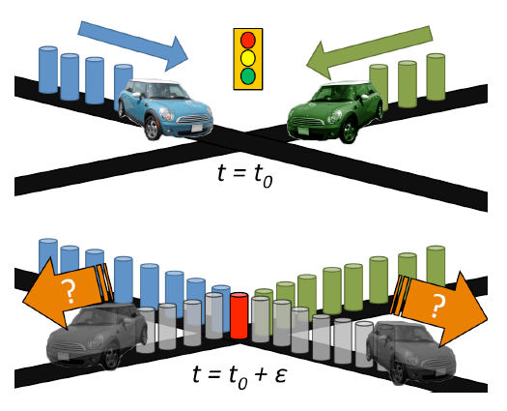
Limitations of Existing Works(Contd.)
Mix Zones
Intersect at different time
Path Confusion
Mix zone + t_{delay}
Similar problem as CliqueCloak, not realtime

Slide 7
CacheCloak – how does it work?
Mediating the flow of data as an intermediary server between users and LBSs
Flow Diagram
User
Request
CacheCloak Server
Cached data
Return
New data requested from the LBS along an entire predicted path

Slide 8
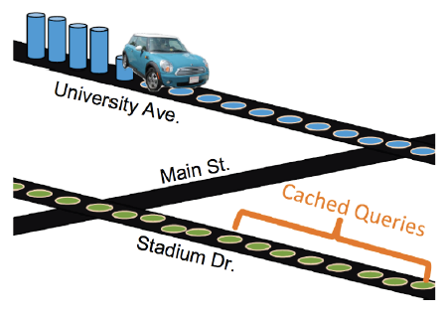
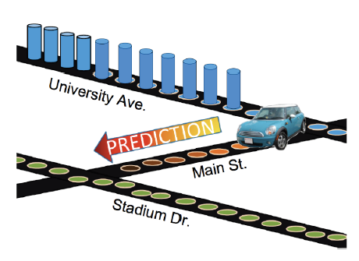
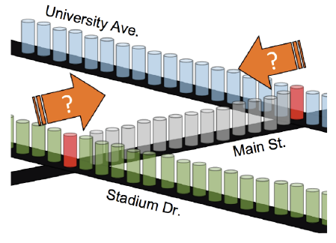
CacheCloak – how does it work?(Contd.)
Prediction path
when cache miss
Extended until it is connected on both ends to existing path is cache
trigger could have come from a user entering either end or first accessing the LBS

Slide 9
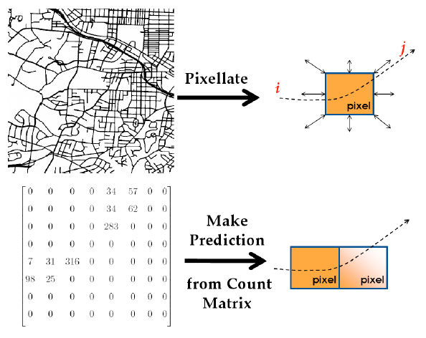

CacheCloak – how does it work?(Contd.)
Implementing CaheCloak
Historical counter matrix C
c_{ij} = # of times a user enters from i and exits toward j
1-bit mask that represent if the data in a pixel is cached
Markov model

Slide 10
Results & Analysis
Privacy Metrics(entropy)
Ex. (x₁,y₁) 0.5, (x₂,y₂) 0.5 ➔ S = -2(0.5 log₂0.5) = 1(bit)
(x₁,y₁) 0.5, (x₂,y₂) 0.25, (x₃,y₃) 0.25 ➔ S = 1.5(bit)
2 bits ~ 4 positions with the same prob.
n bits ~ 2^{n} positions with the same prob.

Slide 11
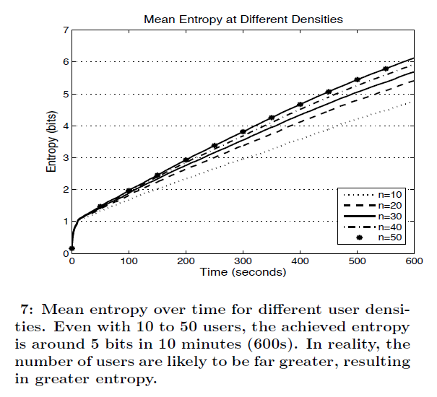
Results & Analysis(Contd.)

Slide 12
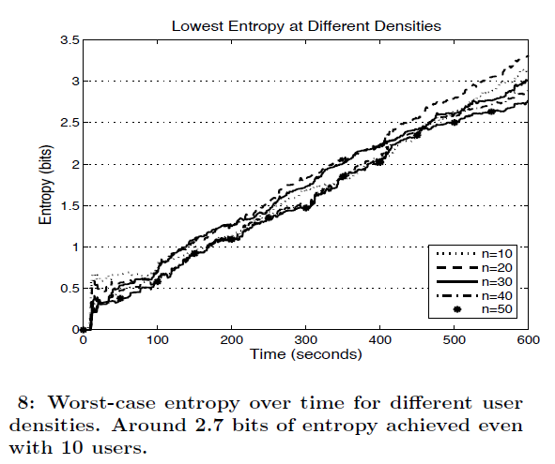
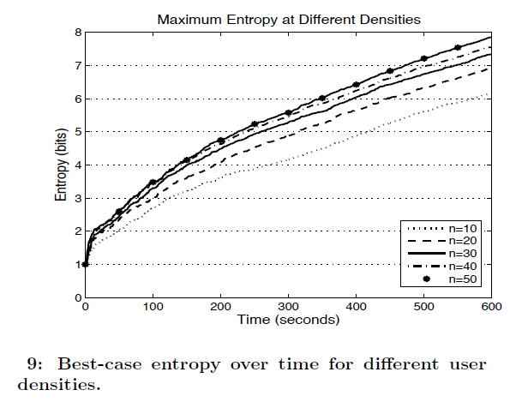
Results & Analysis(Contd.)

Slide 13
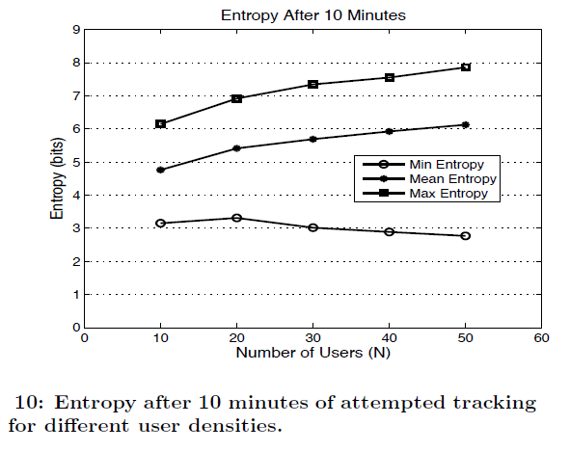
Results & Analysis(Contd.)

Slide 14
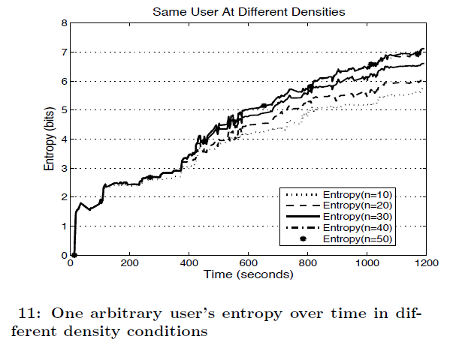
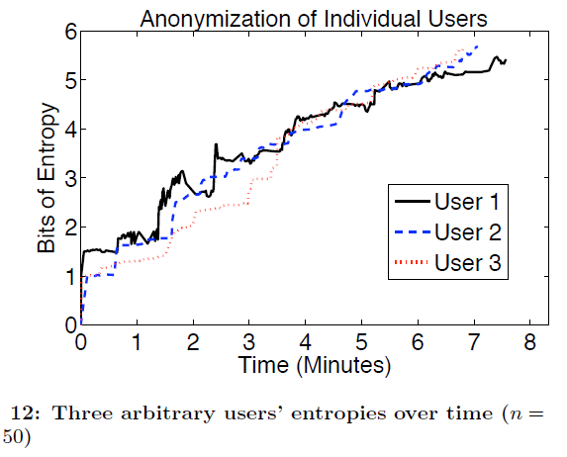
Results & Analysis(Contd.)

Slide 15
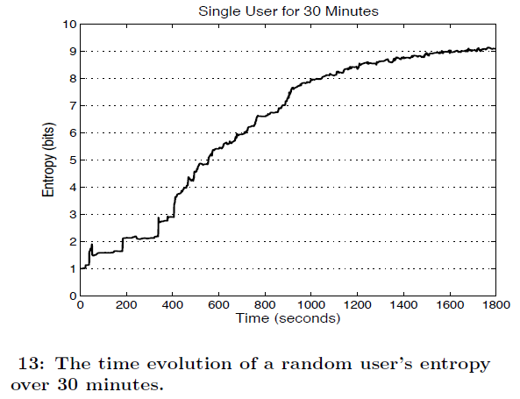
Results & Analysis(Contd.)

Slide 16
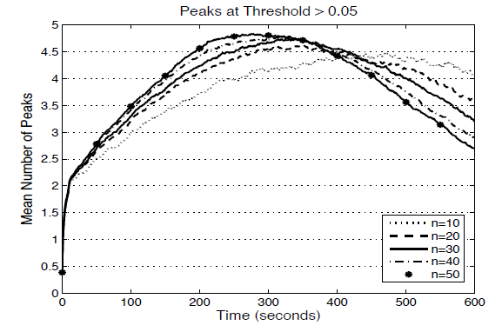
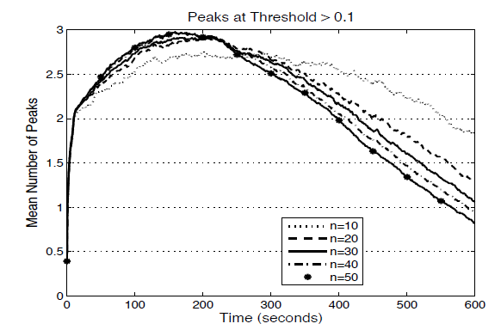
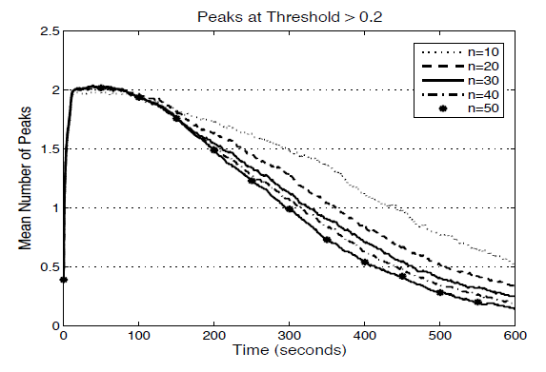
Results & Analysis(Contd.)

Slide 17
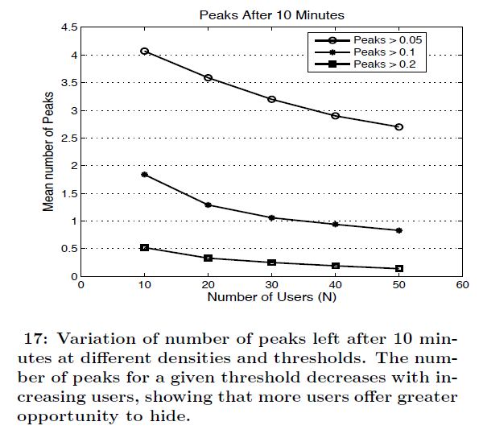
Results & Analysis(Contd.)

Slide 18
Conclusion
If there is a comparison between CacheCloak and other existing works, it would be easier to see how great CacheCloak is.
Overall, CacheCloak may be a good solution to location privacy because it provide realtime anonymization of location data without trade functionality off.

Slide 19
The End
Thank You~

